Slide 1
Lecture 2 – Linear Regression

Slide 2
Regression
Supervised learning technique
Used when the value that you want to predict is a continuous variable
e.g. - Predicting the height of a person based on the nationality, age, gender….
- Predicting the housing price based on the floor area, no. of floors, city……
- Predicting the value of a share based on the company revenue, profit,……

Slide 3
Outline
Why regression?
Linear regression with one variable
Linear regression with multiple variables
Polynomial regression
Dealing with common issues
Normal equation

Slide 4
Linear regression with single variable

Slide 5
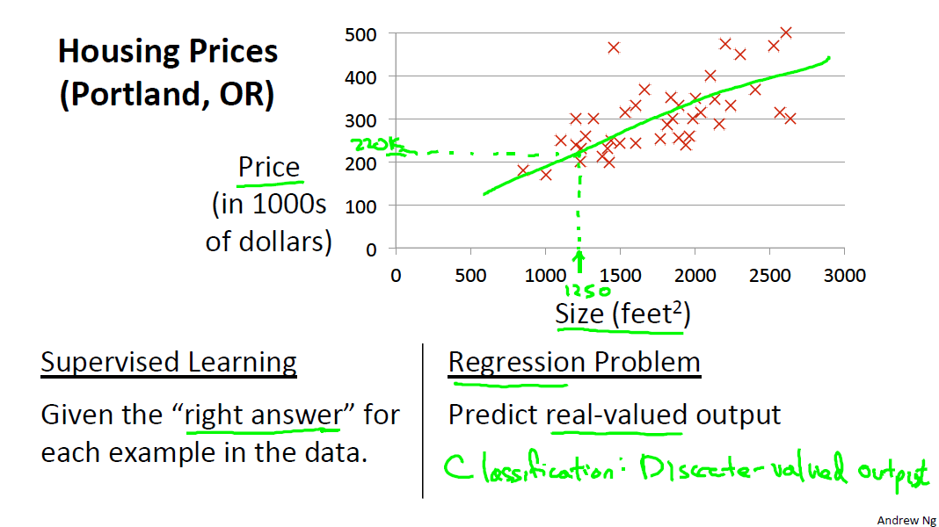

Slide 6
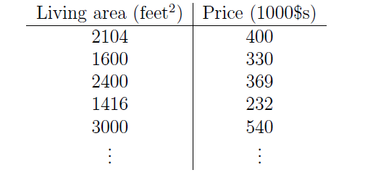
Training Data Example
TO DO: Write the notation……

Slide 7
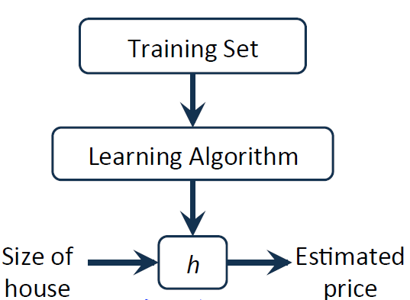
Learning process
TO DO – Write the Hypothesis

Slide 8
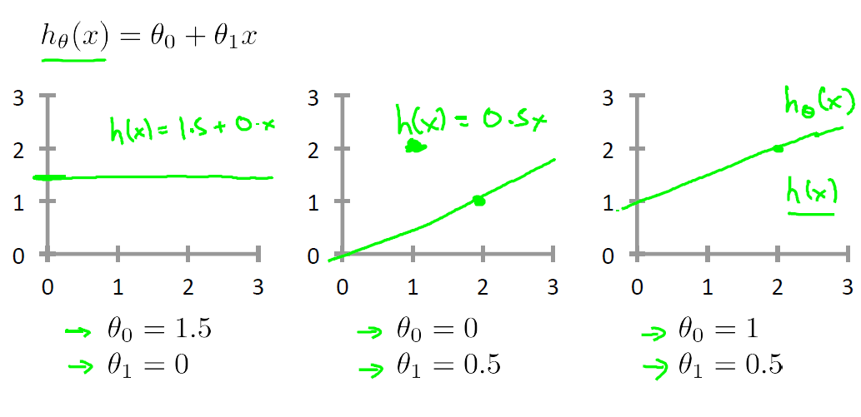
Hypothesis

Slide 9
Cost Function
TO DO

Slide 10
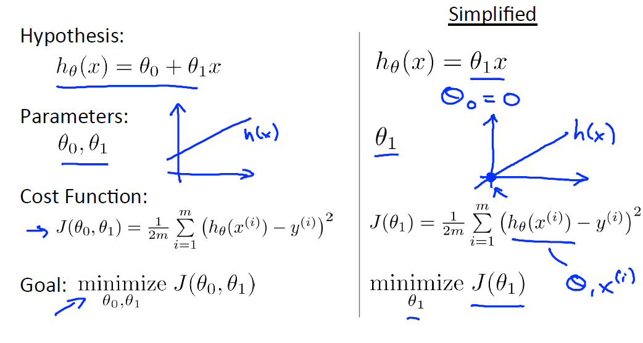

Slide 11
Hypothesis vs. Cost function
TO DO

Slide 12
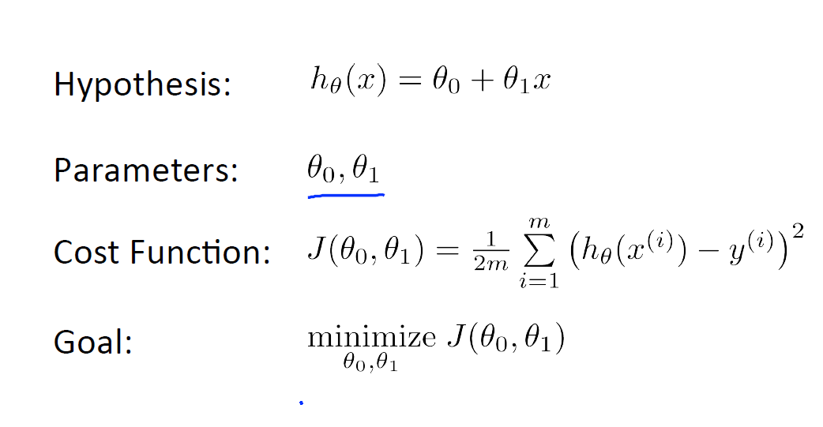

Slide 13
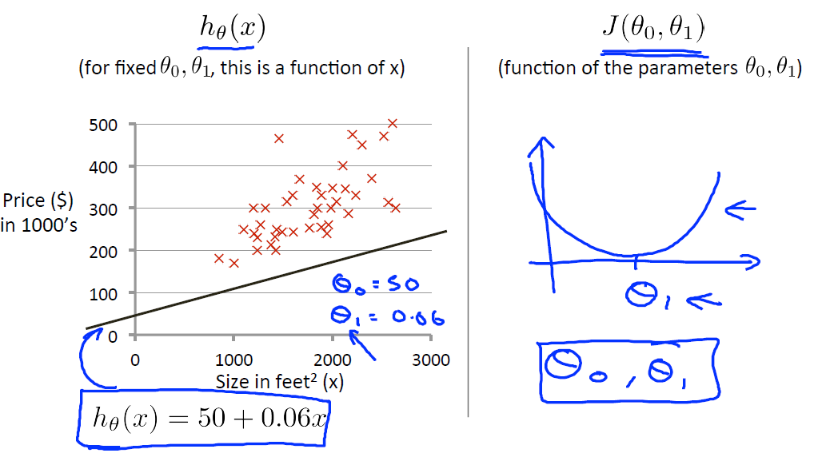

Slide 14
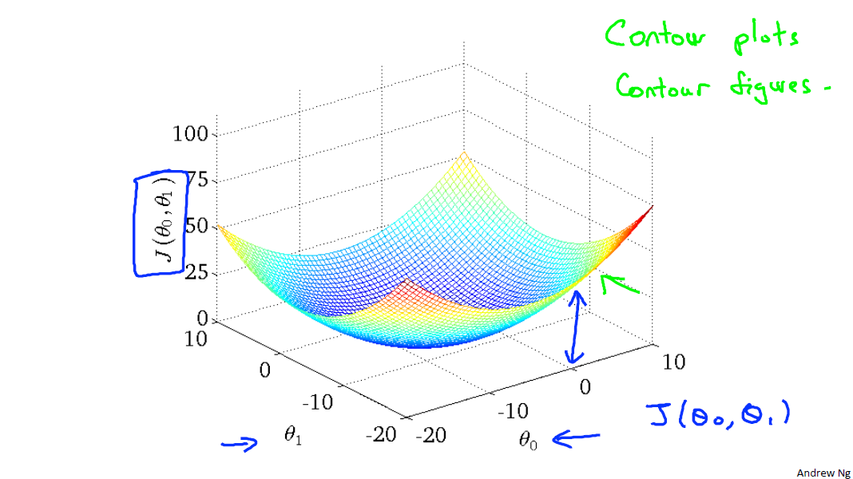

Slide 15
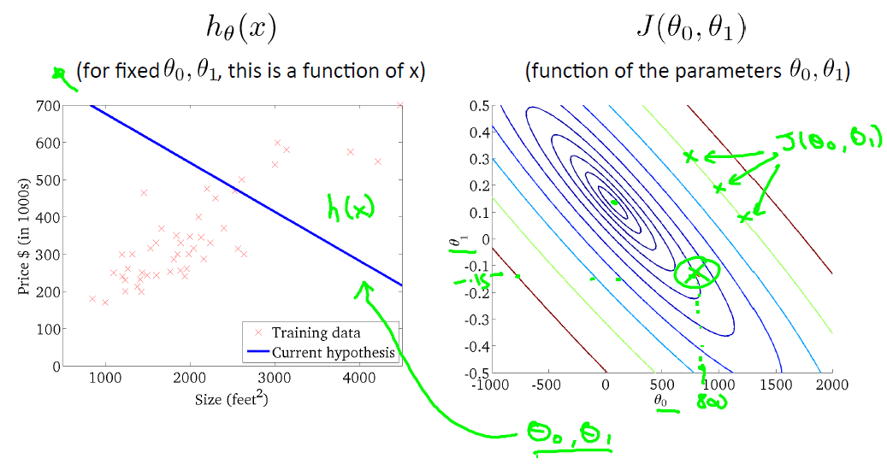

Slide 16
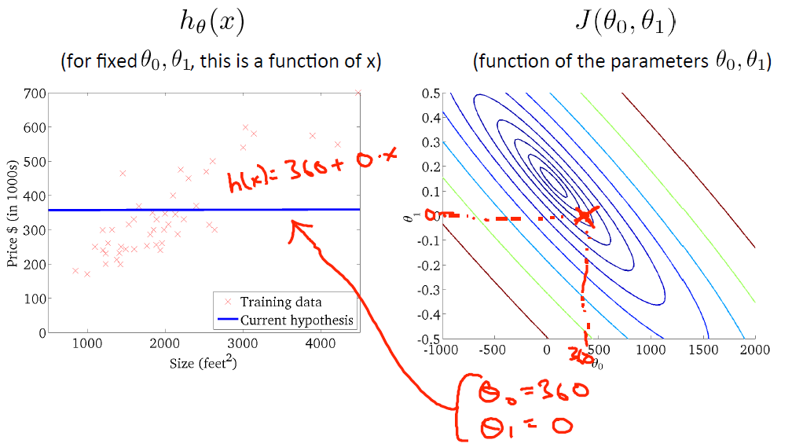

Slide 17
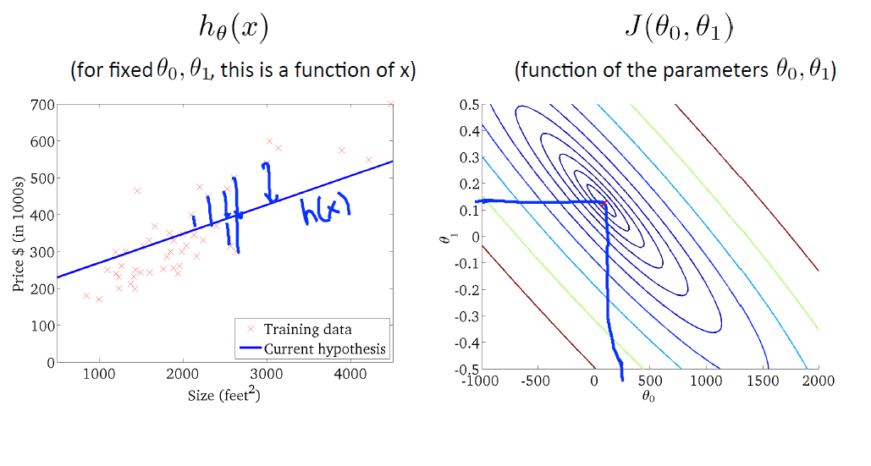

Slide 18


Slide 19


Slide 20
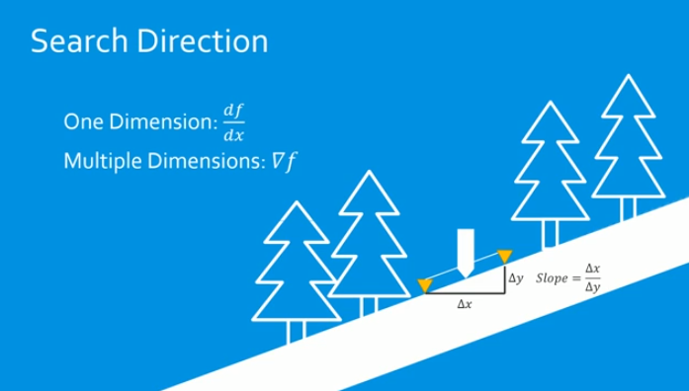

Slide 21


Slide 22


Slide 23


Slide 24
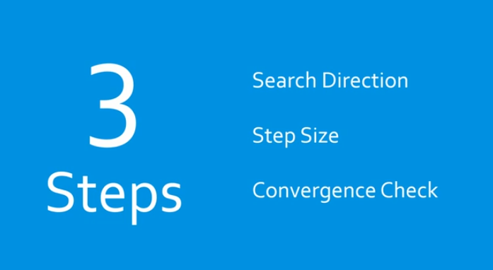

Slide 25
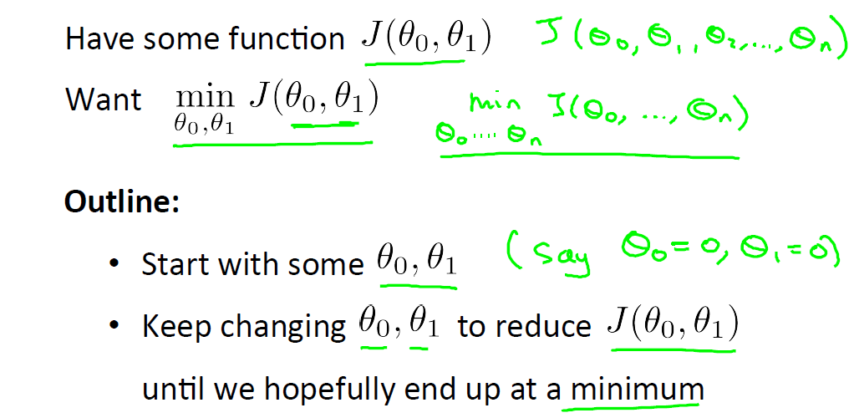
Gradient Descent

Slide 26
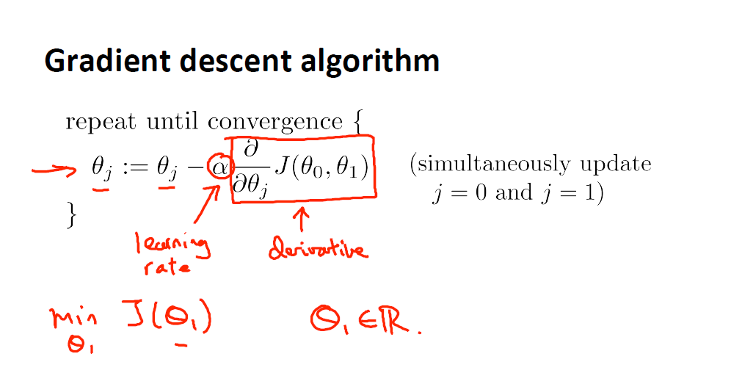
TO DO: Positive and Negative gradients

Slide 27
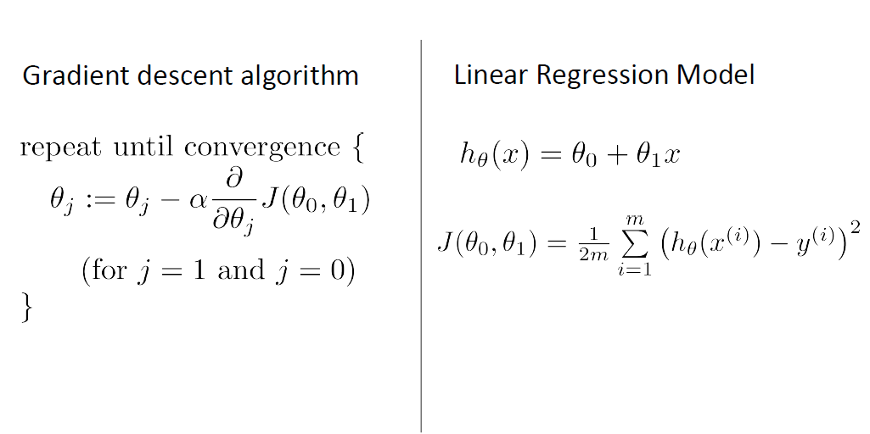
TO DO: Derivation

Slide 28
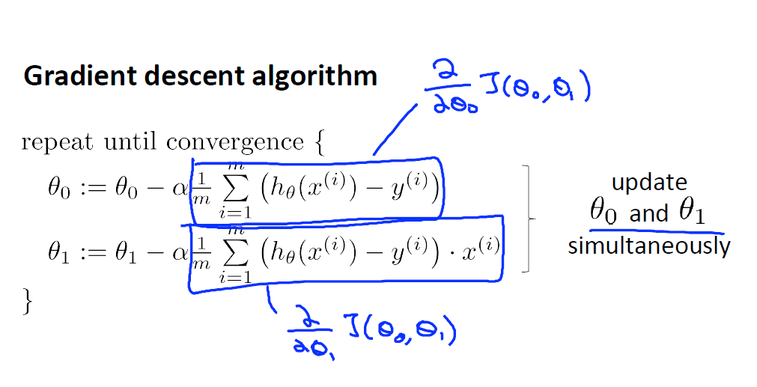

Slide 29
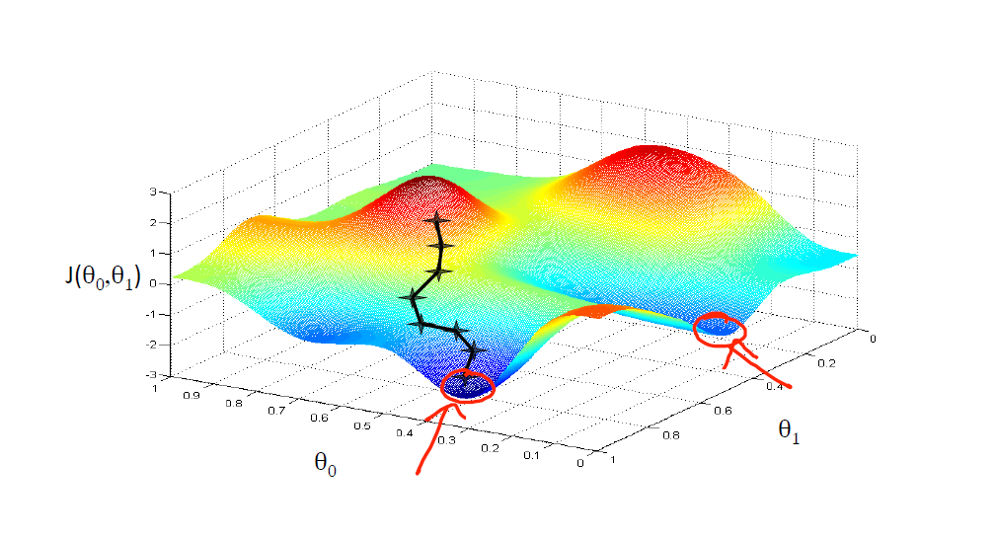

Slide 30
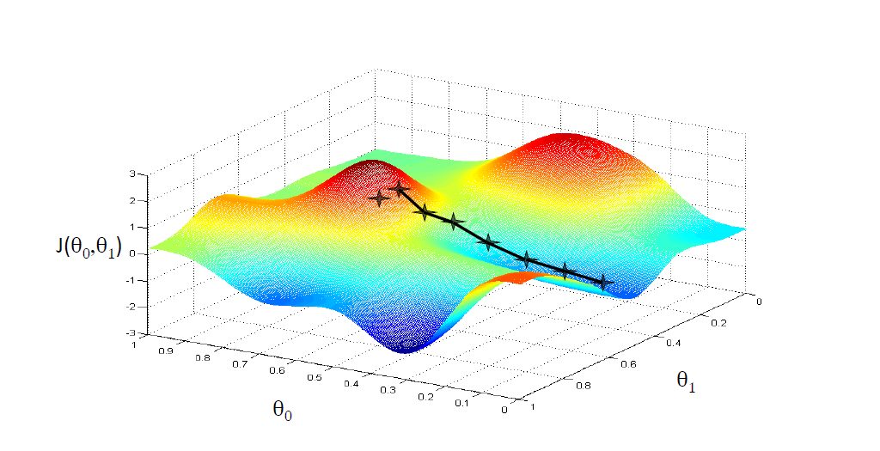

Slide 31
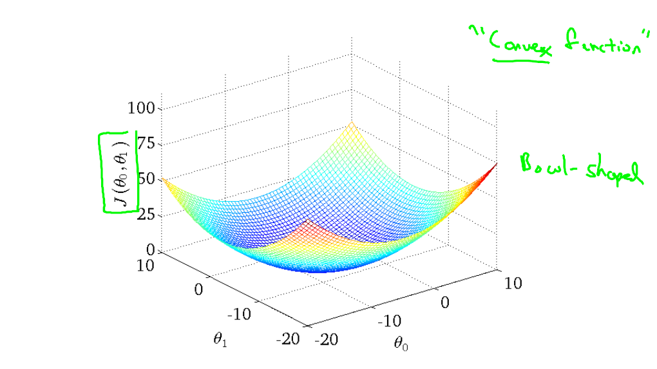

Slide 32
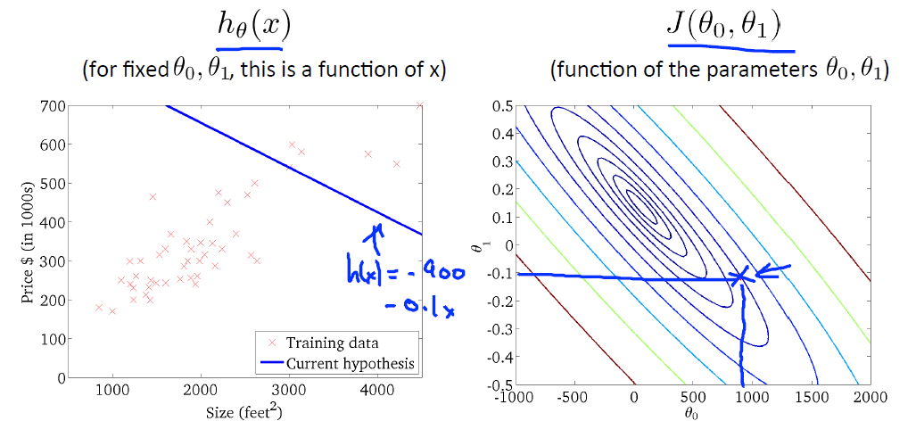

Slide 33
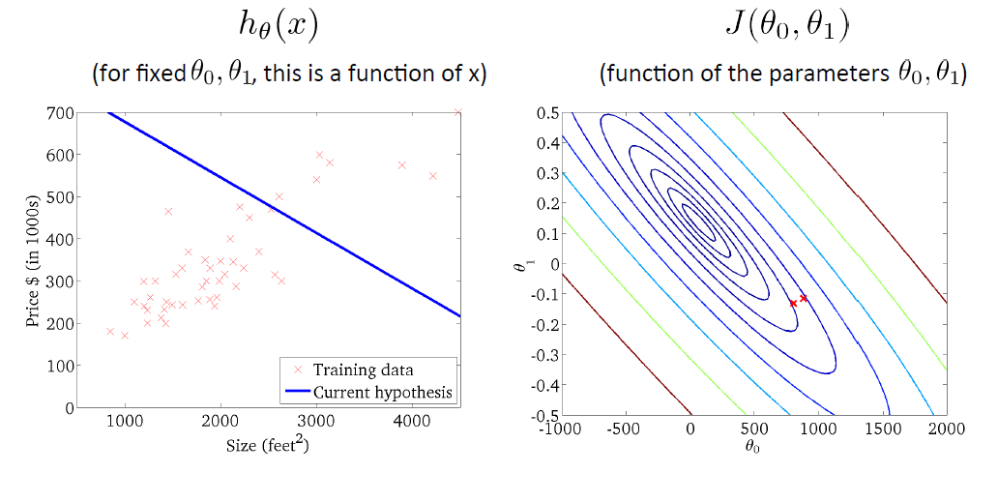

Slide 34
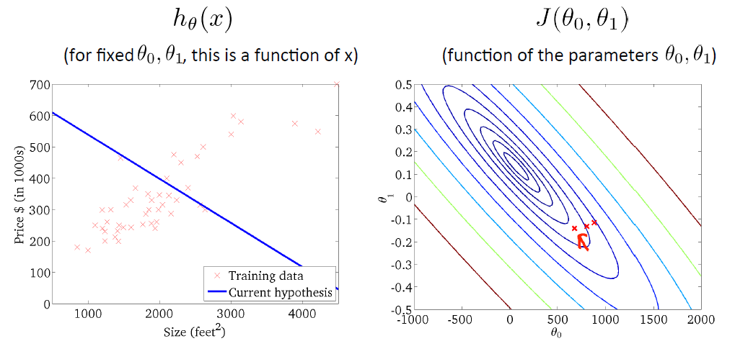

Slide 35
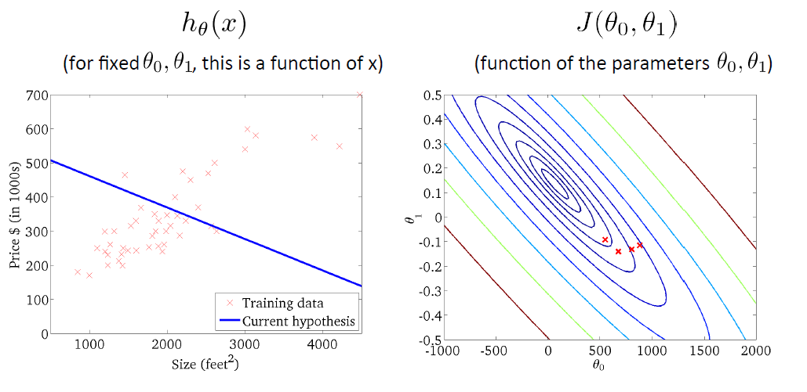

Slide 36
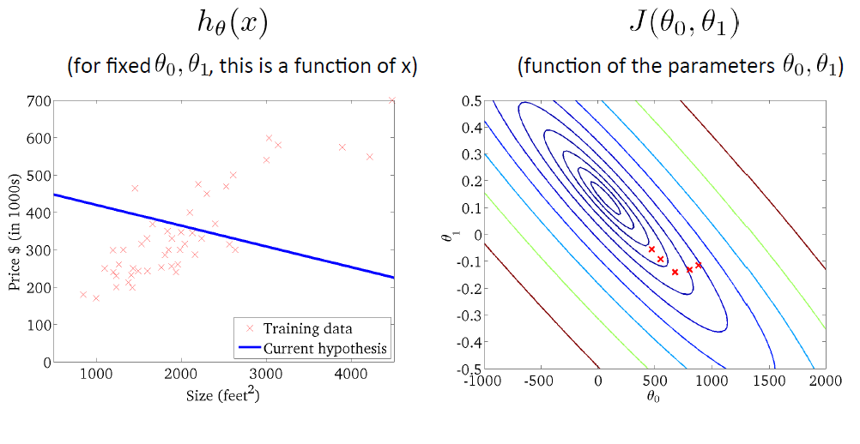

Slide 37
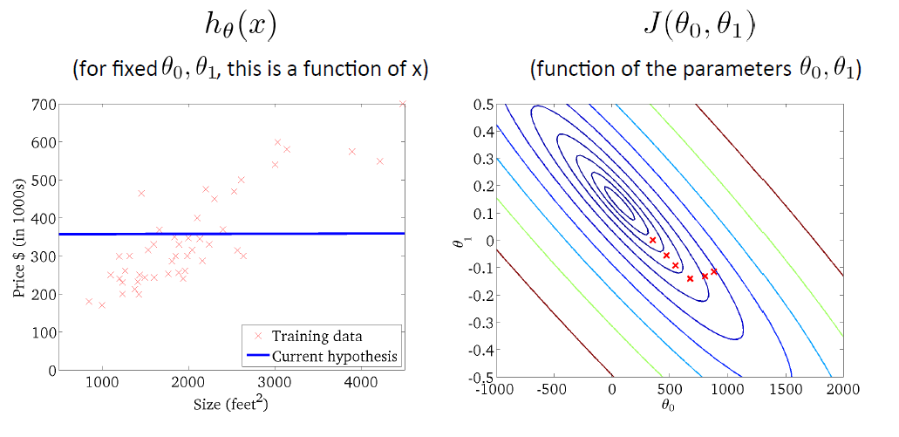

Slide 38
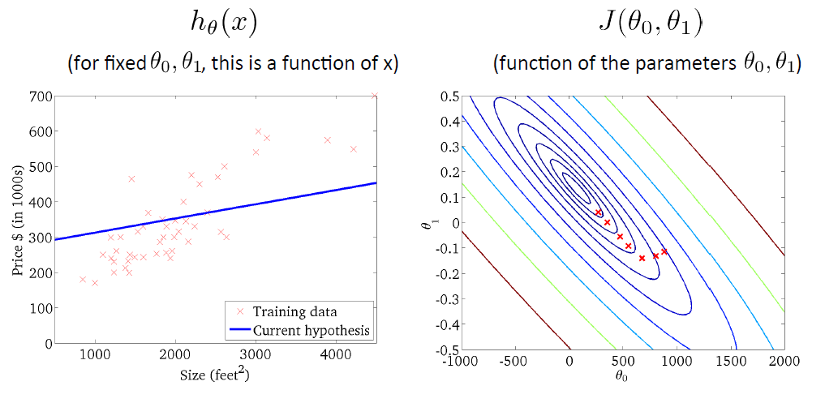

Slide 39
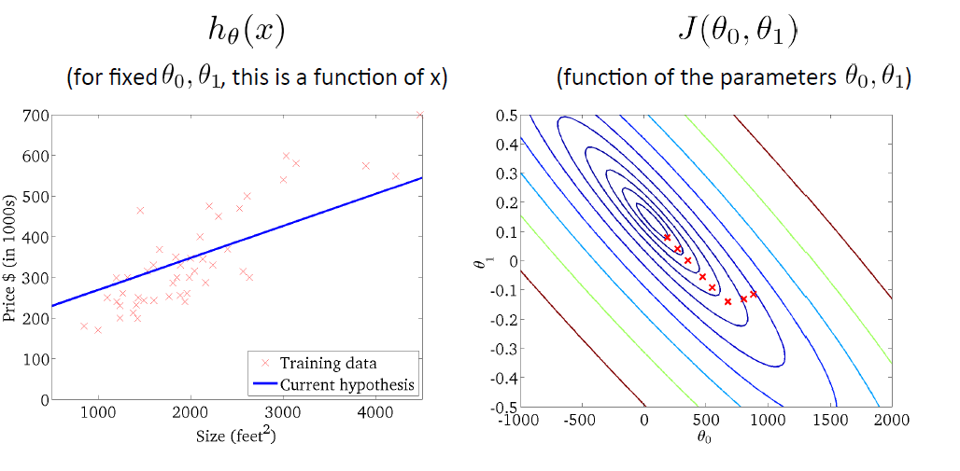

Slide 40
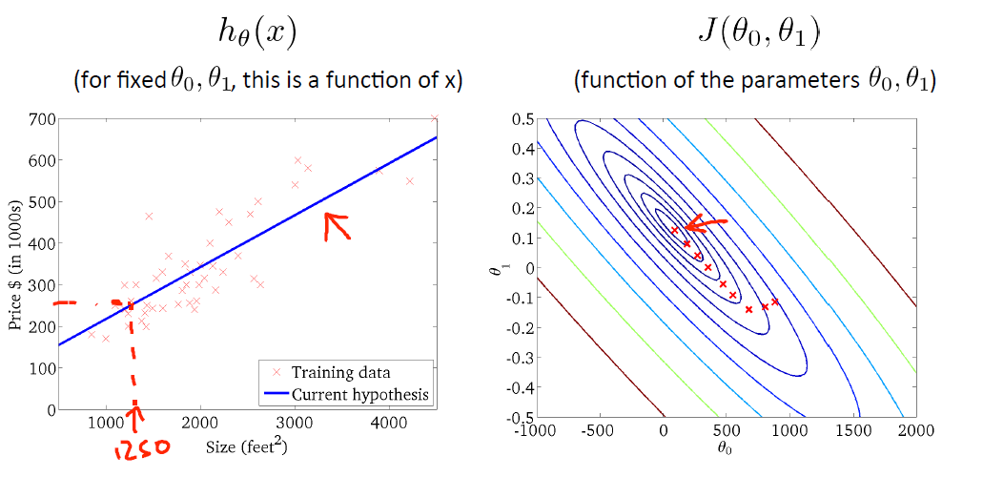

Slide 41
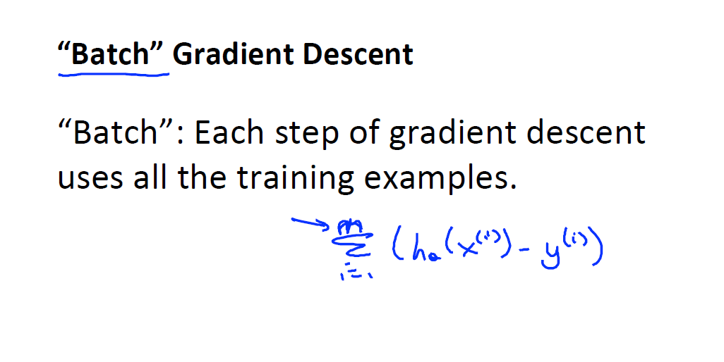

Slide 42
Linear regression with multiple variables

Slide 43
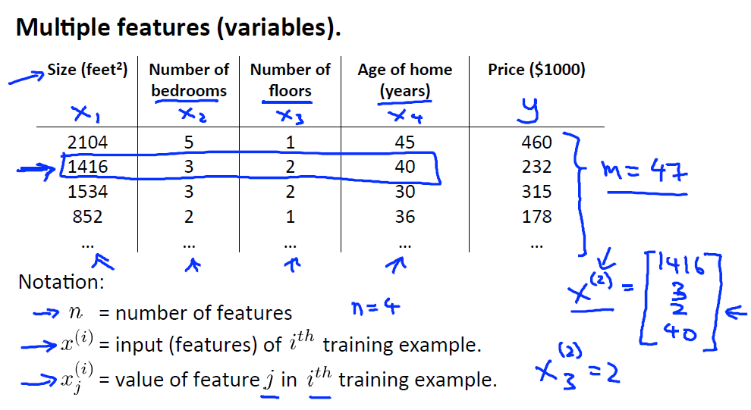

Slide 44
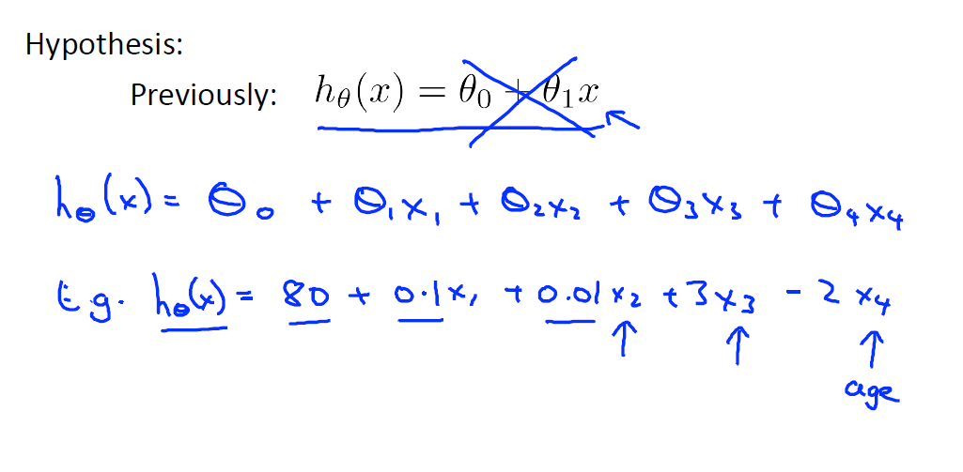
TO DO: Vector notation

Slide 45
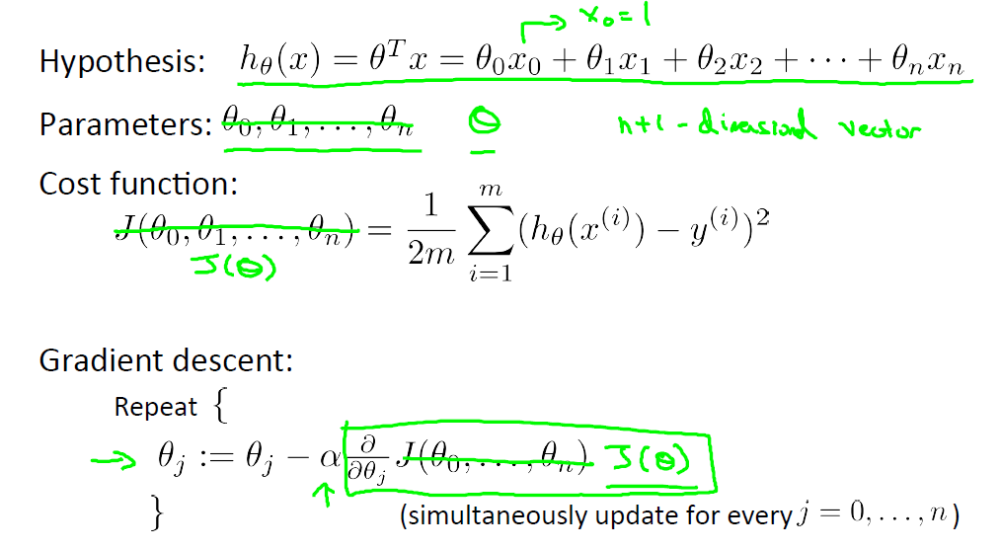

Slide 46
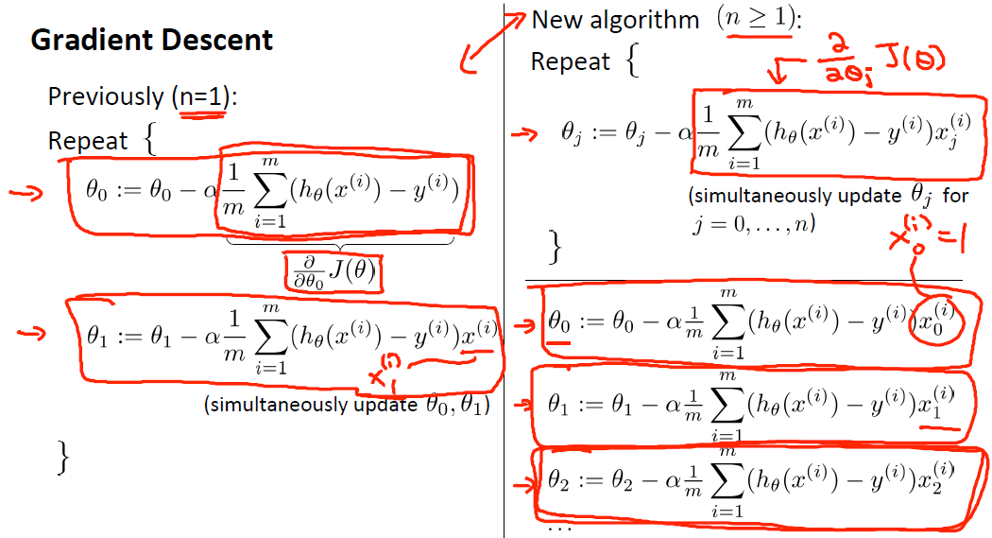

Slide 47
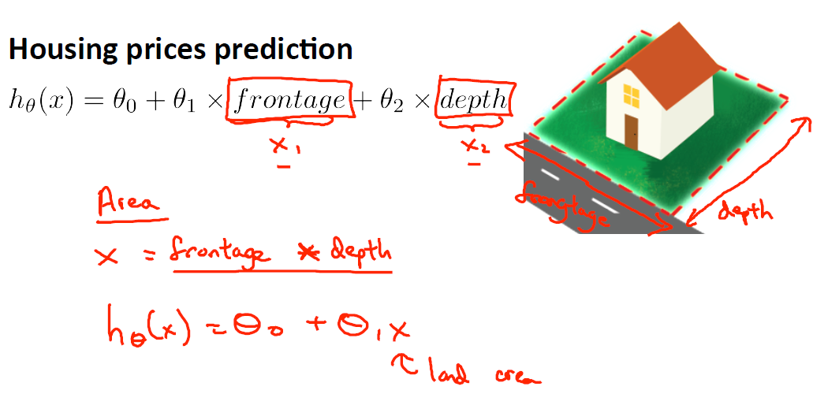
Polynomial regression

Slide 48
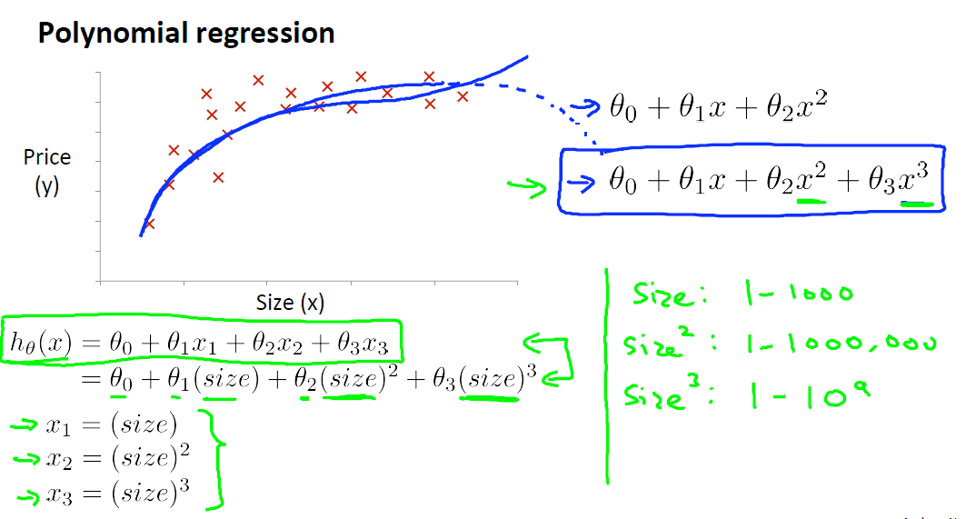

Slide 49
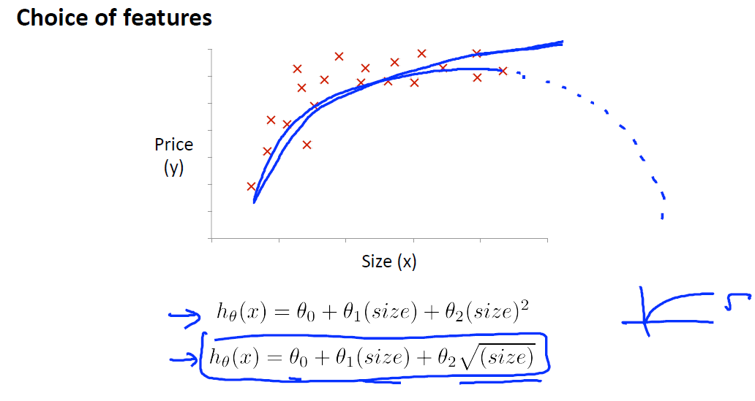

Slide 50
Gradient descent for polynomial regression
Since the cost function is not convex now, we might get stuck in local minima
No straight-forward solution for this
Have to try different initial values for ϴ

Slide 51
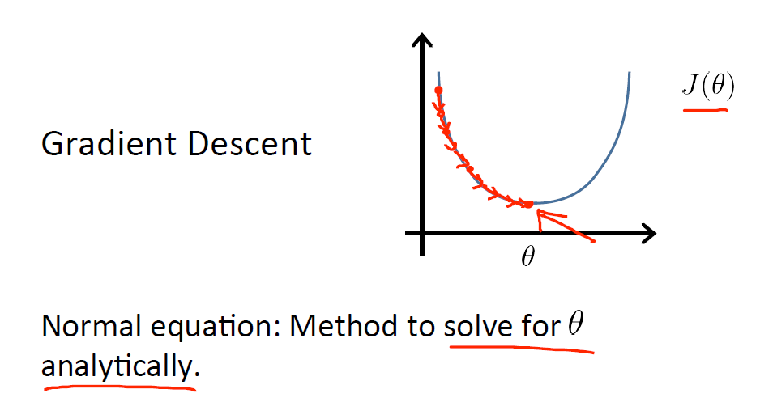
Normal equation

Slide 52
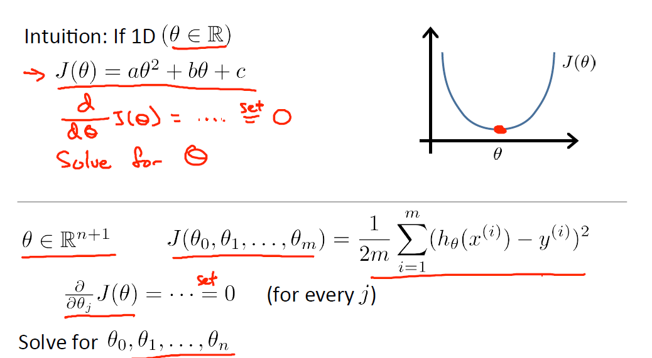

Slide 53
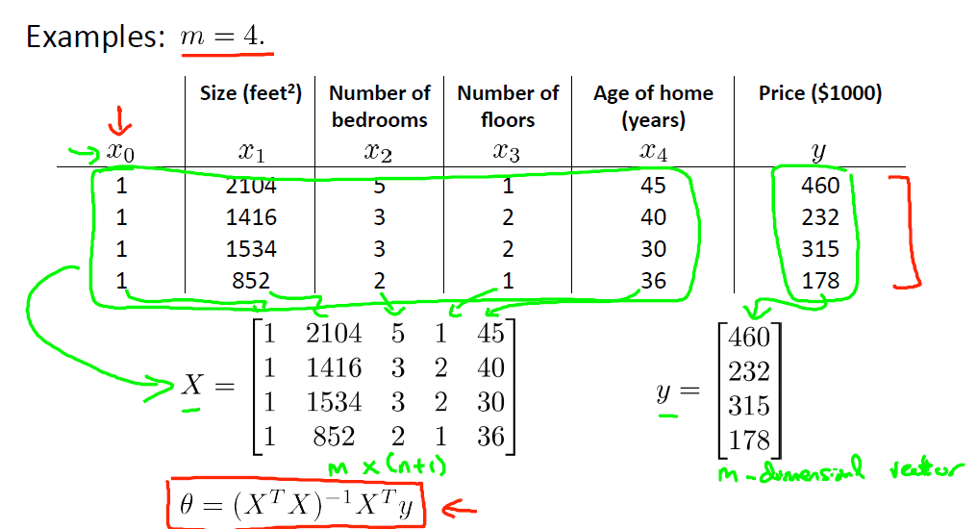

Slide 54
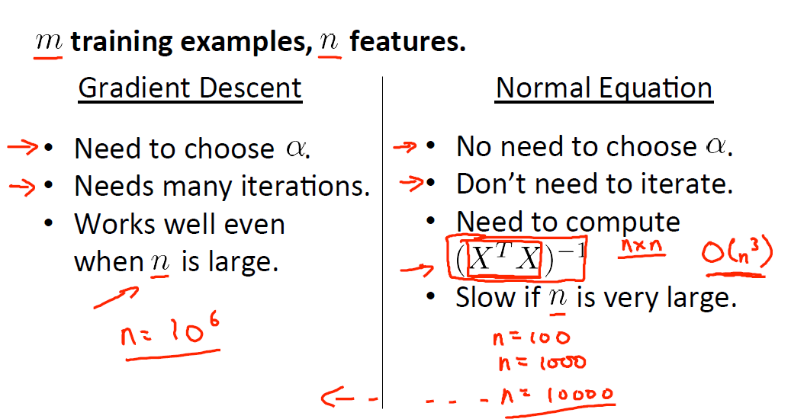

Slide 55
Common issues and how to overcome them
Learning rate
Feature Scaling
Overfitting and underfitting (bias and variance)

Slide 56
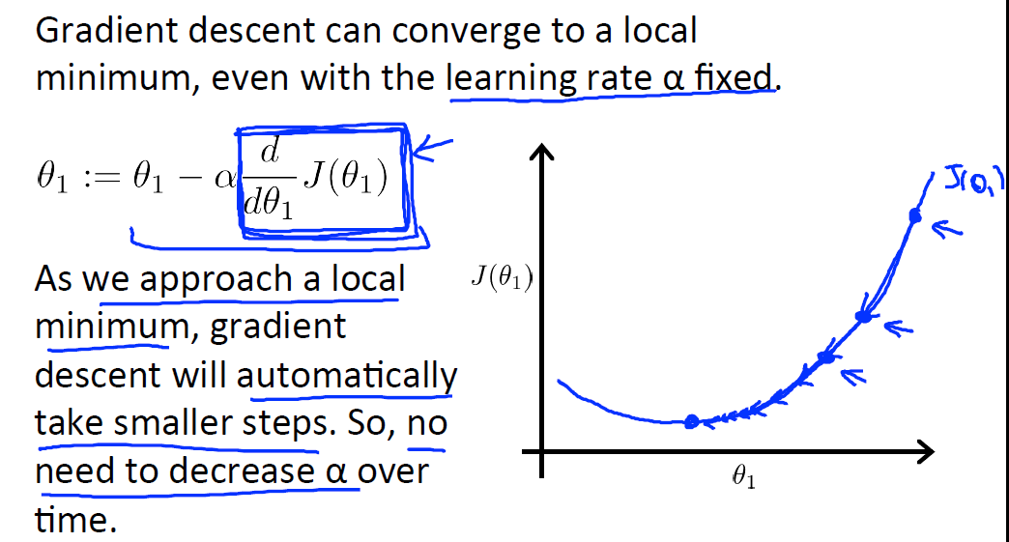

Slide 57
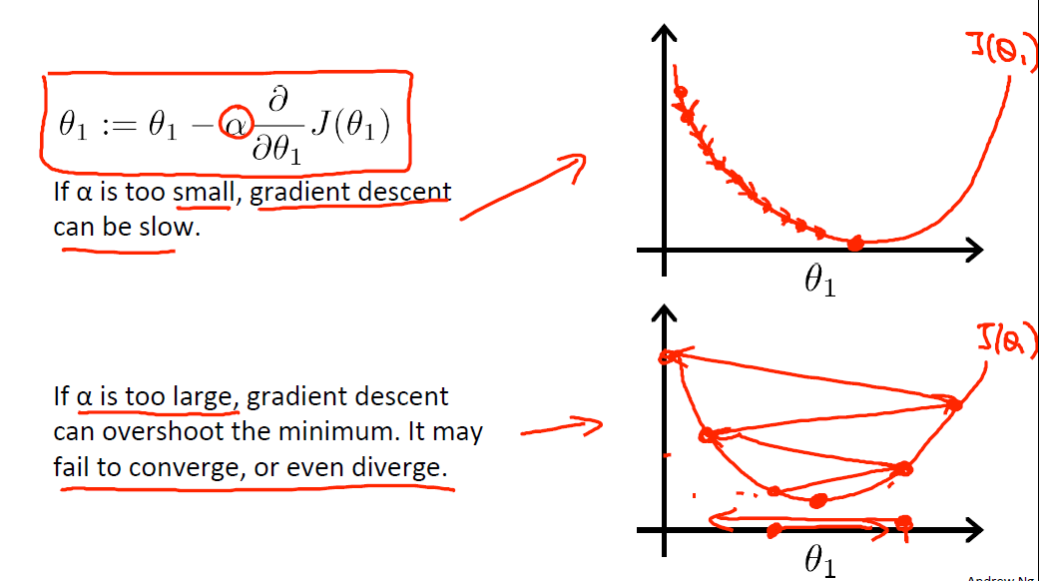
Learning rate

Slide 58
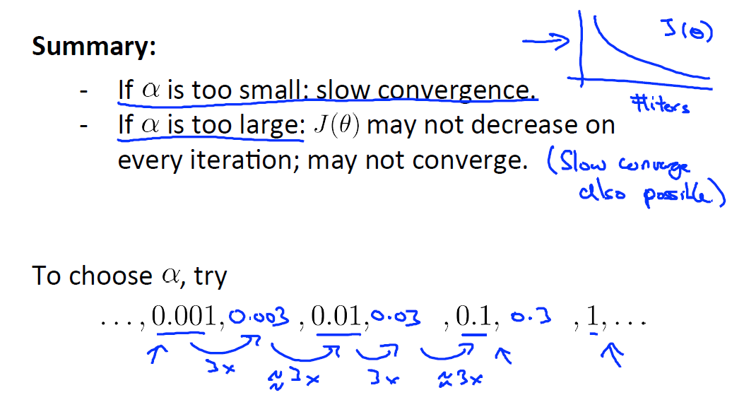

Slide 59
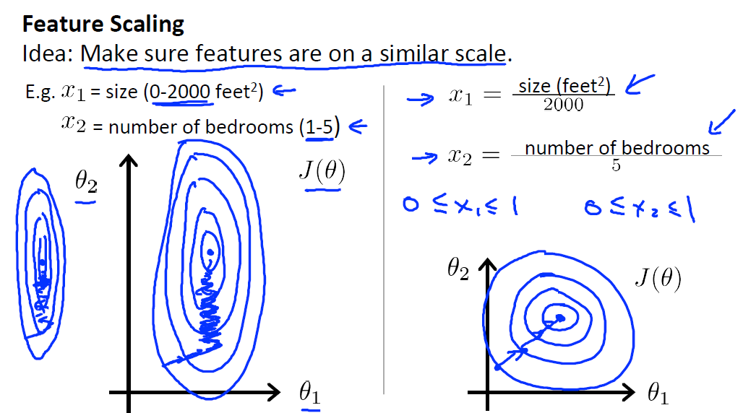

Slide 60
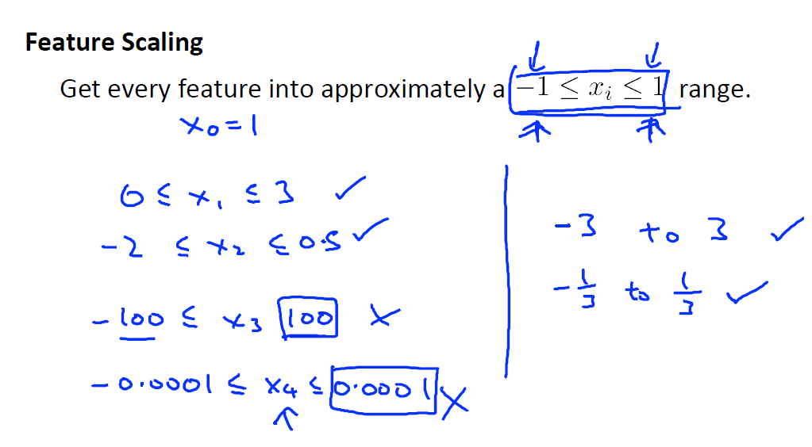
TO DO : Mean normalization

Slide 61
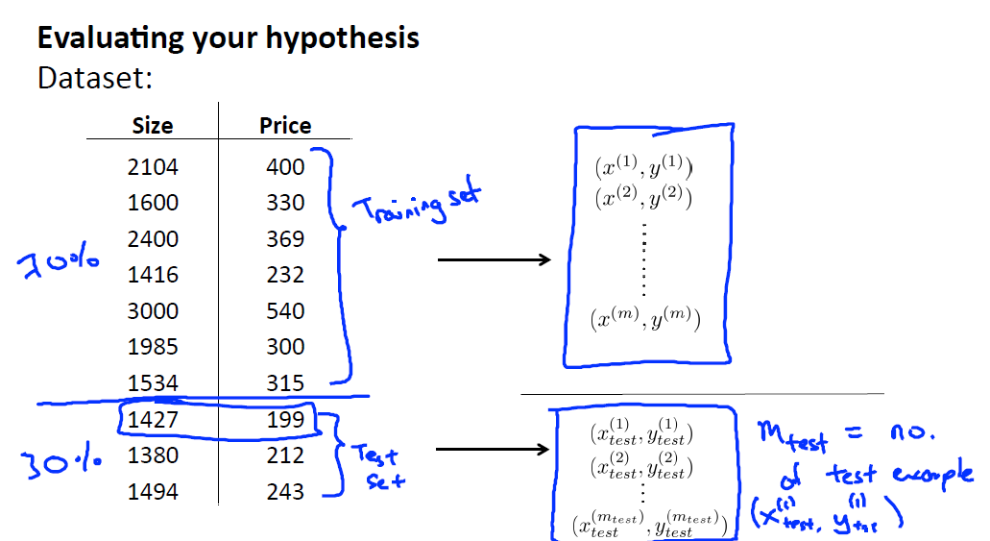

Slide 62
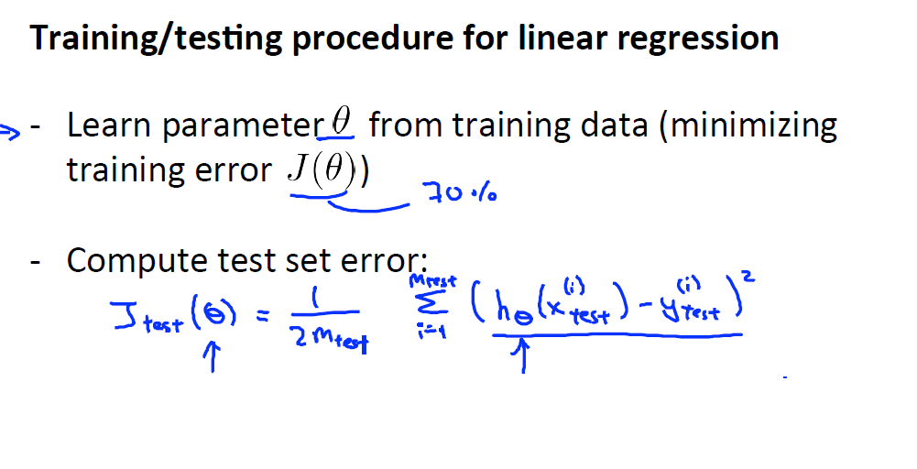

Slide 63
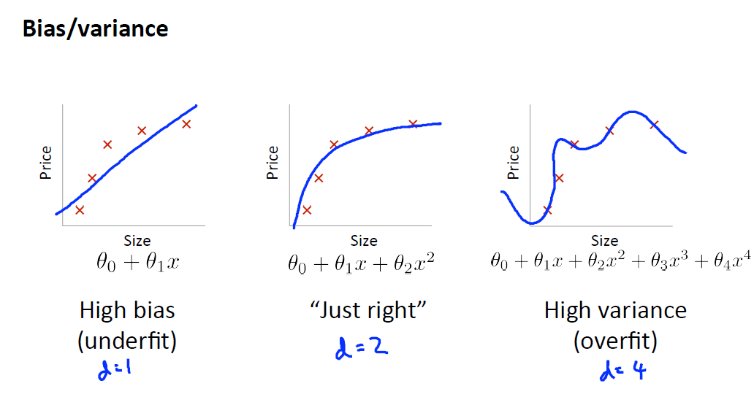

Slide 64
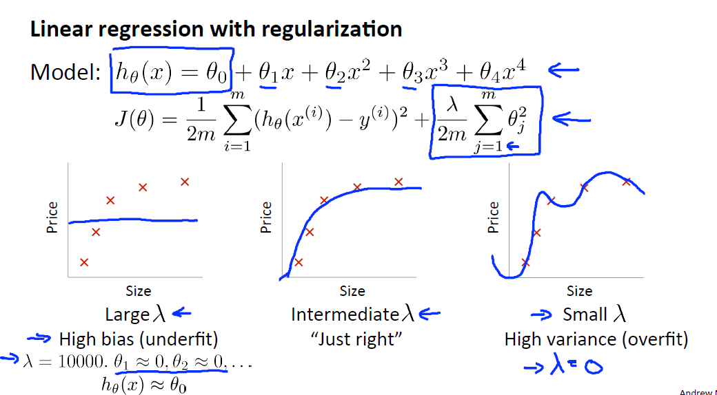

Slide 65


Slide 66


Slide 67


Slide 68
Overfitting and Underfitting
If the linear regression/learning algorithm, is suffering from overfitting, getting more training data may help.
If the linear regression/learning algorithm is suffering from underfitting, the hypothesis has to be changed (the order of the hypothesis has to be increased/or made more complex in the case of Linear Regression)
Else, can adjust the regularization term to fix overfitting or underfitting

Slide 69
Summary
Linear regression is used to predict continuous values based on historical data
Supervised learning technique (as historical values are there)
Linear regression with single feature
Linear regression with multiple features
Polynomial regression

Slide 70
Summary
Gradient descent (iterative method to solve regression problems)
Normal equation (analytical method to solve regression problems)
Common issues
- Learning rate
- Feature scaling
- Overfitting and underfitting

